Slide 1
3471 Project
Runtime Terror:
Ashley Bickham, Joshua Hunter, Austin Lehman, Tyler Ross

Slide 2
Project Vision / Analysis
This software will benefit the user because it will allow for easy management of an online store’s inventory, allowing the store to add/remove items, keep track of the total inventory, keep track of orders. The system will manage the store’s inventory allowing the employees to focus on other tasks. The main stakeholders for this project are the customers of the store and the store’s employees. The customers will only be able to purchase the items if they are in stock, and the employees will need to know if stock is getting low so that they can order more. The system will have a GUI that allows for the user to look up an item by an ID number and see its stock, a general description, and make a purchase. The software will also need to keep track of the items that the customer has added to their cart, to enable the purchase of multiple items

Slide 3
User Roles
Ashley- Wireframes
Joshua- Traceability Matrix
Austin- Website creation & management
Tyler- Domain Model

Slide 4
Website
https://runtimeterrorbu.github.io/InventoryManagement/

Slide 5
Requirements
R1: The system will keep a set of items that are sold by the store
R2: The store will be able to add and remove from the set of items
R3: Items will be associated with a unique ID to allow for easy lookup and management
R4: The system will keep track of the amount of each item that is available for sale
R5: Customers will be able to add and remove items they wish to purchase into a cart
R6: The system will be able to keep track of each order by its unique ID
R7: Each order will be stored in a database to allow for easy lookup
R8: Customers must be able to make accounts easily
R9: When stock is low, the system must notify an employee or manager
R10: Customers can rent items that allow it.
R11: Customers can return items that have been rented.
R12: If a customer’s rental is late a fee should be sent to them.
R13: The customer should be able to return an item within 30 days.
R14: The customer should be able to search for items.
R15: The customer should be able to add items to a wishlist.
R16: The system should notify the customer when an item in their wishlist is in stock.
R17: The system should notify the customer when an item in their wishlist is on sale.

Slide 6
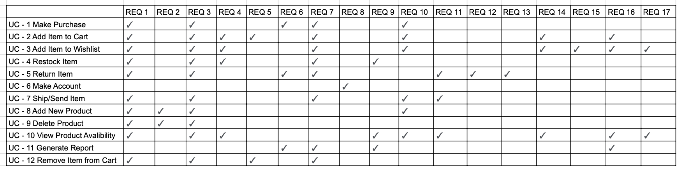
Traceability Matrix

Slide 7
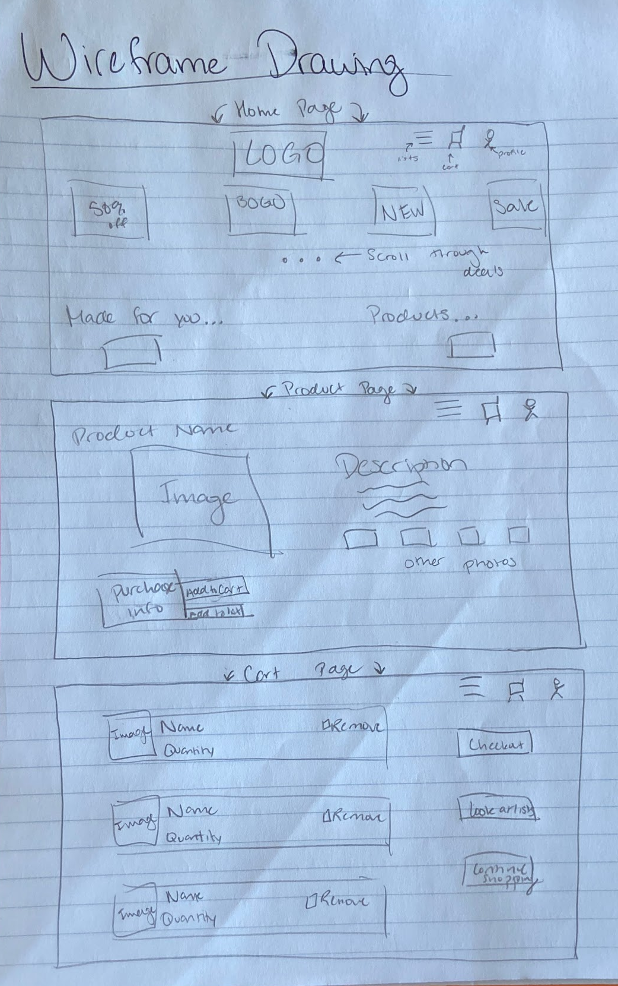
User Interface Sketches

Slide 8
Use Cases
Make Purchase Ashley
Add Item to Cart Austin
Add Item to Wishlist Tyler
Stock Item Joshua
Return Item Ashley
Make Account Austin
Send/Ship Item Tyler
Add New Product Tyler
Delete A Product Joshua
View Product Availability Joshua
Generate Report Ashley
Remove Item from Cart Austin

Slide 9
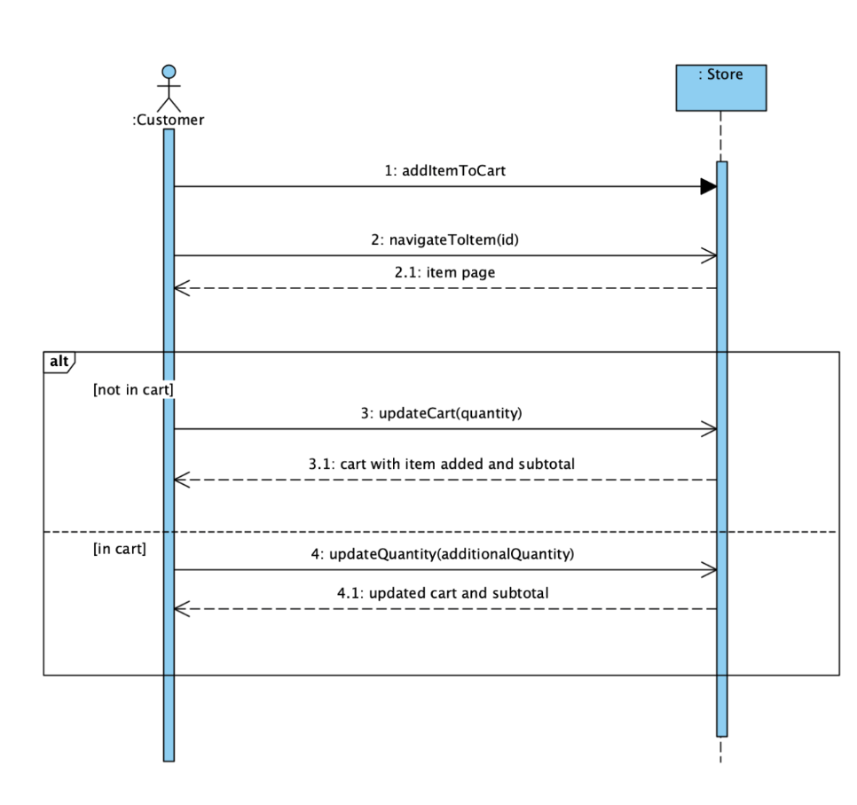
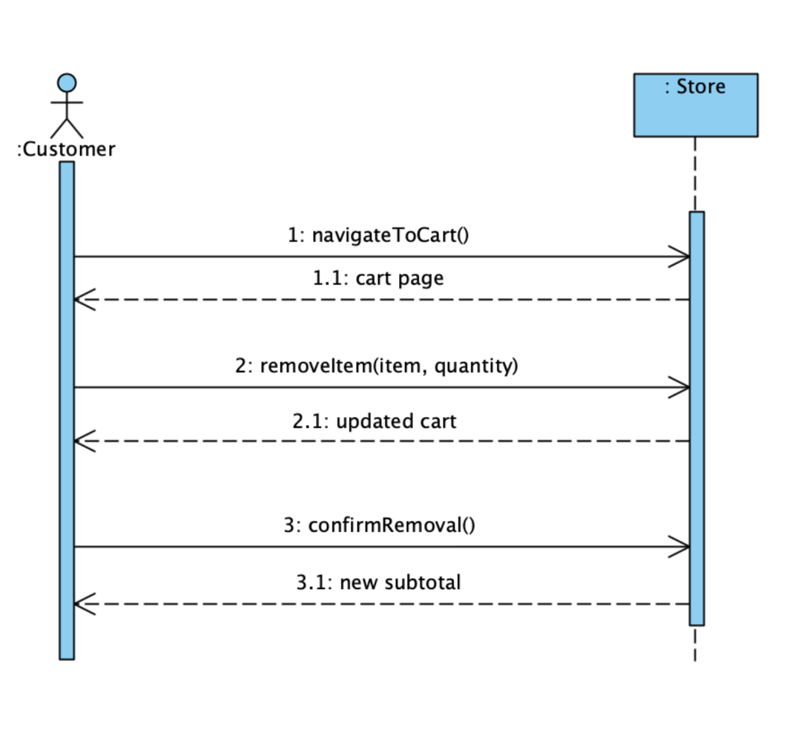
SSD

Slide 10
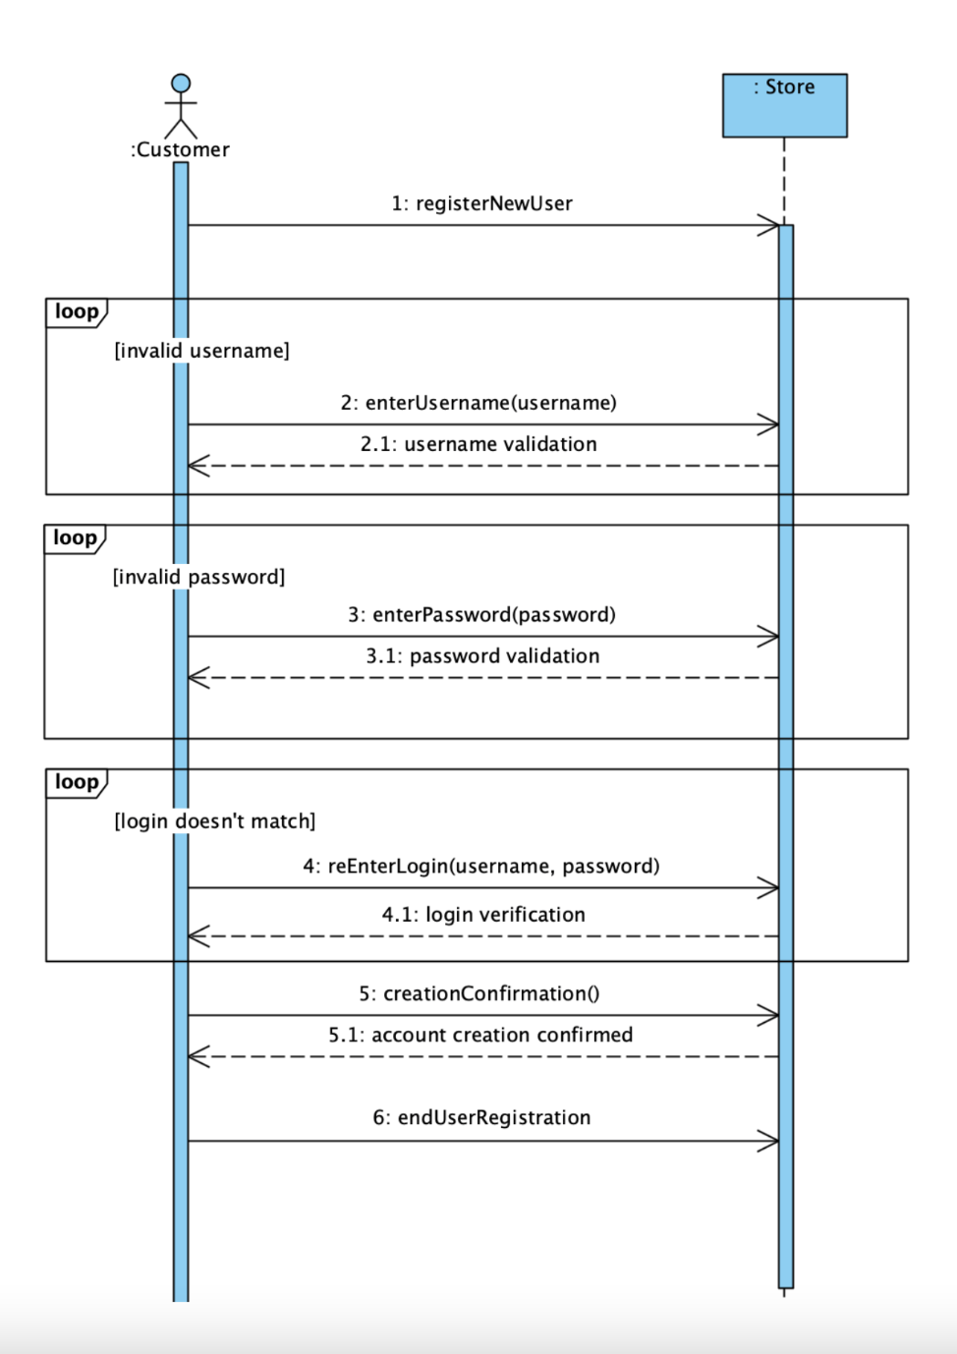
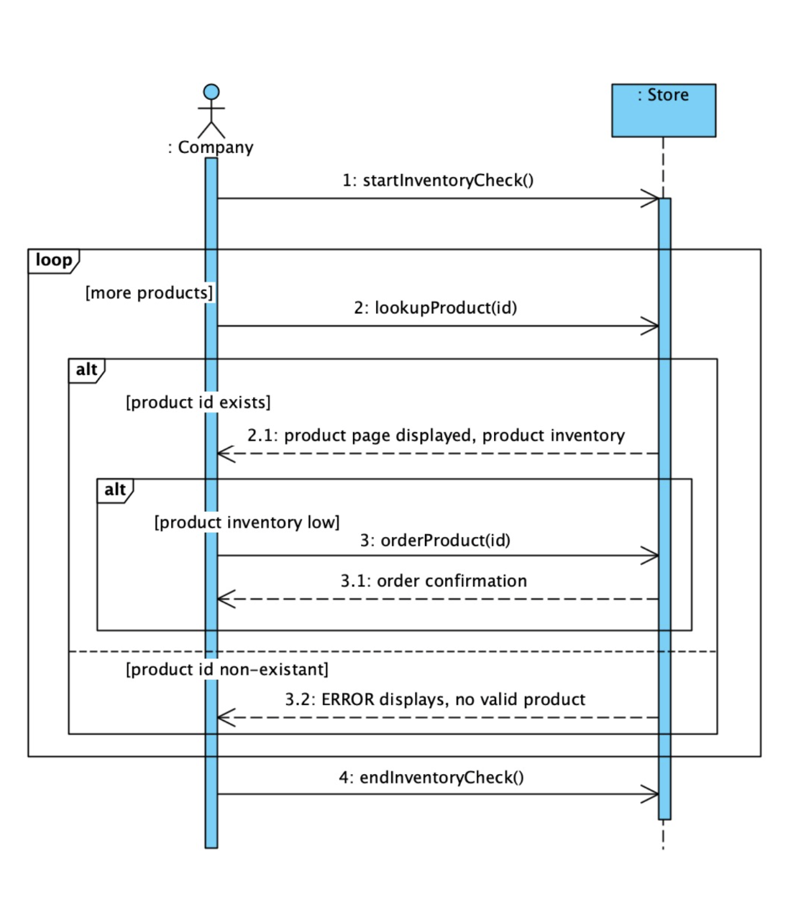
SSD

Slide 11
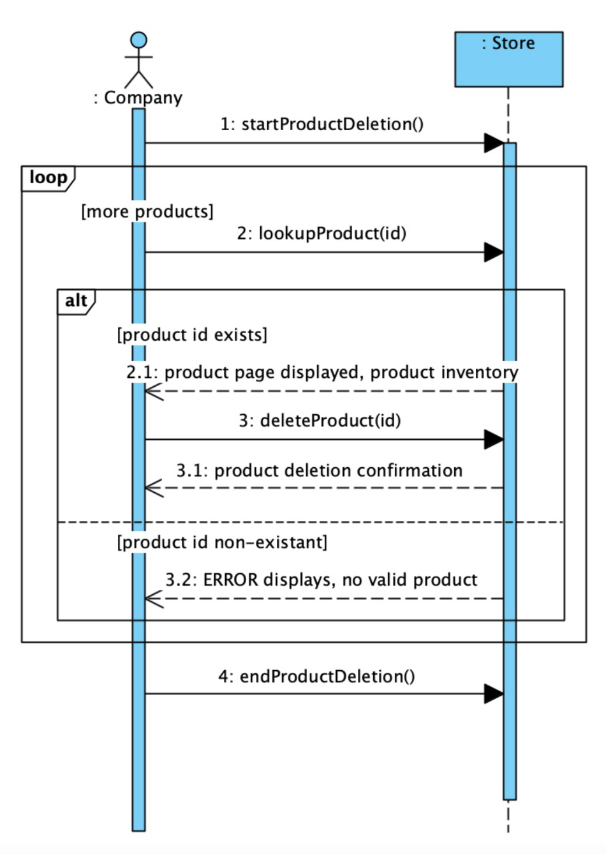
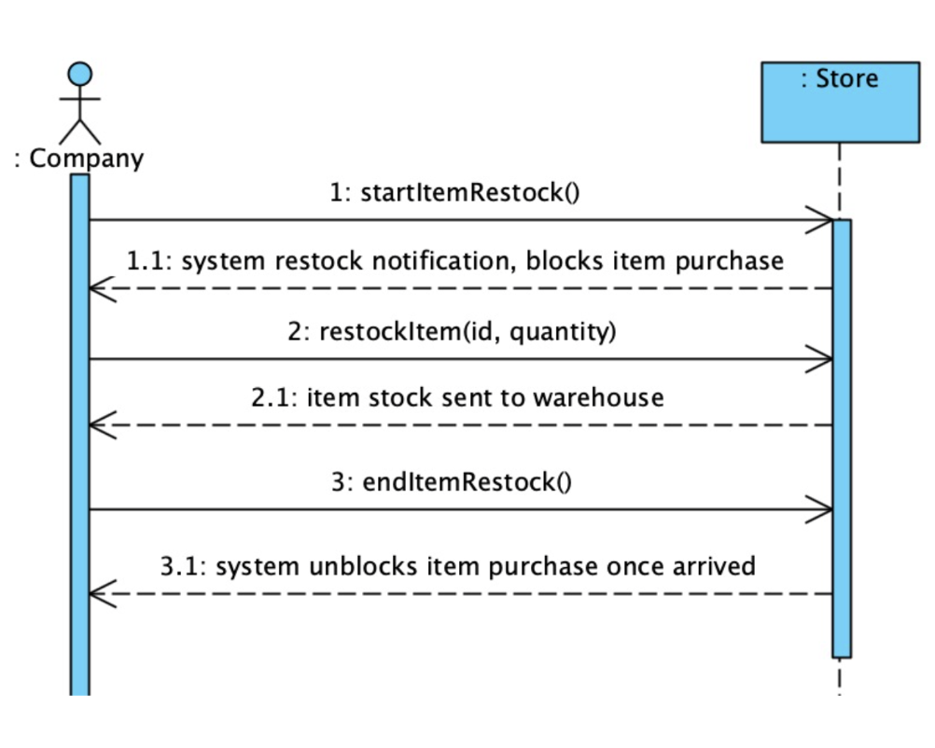
SSD

Slide 12
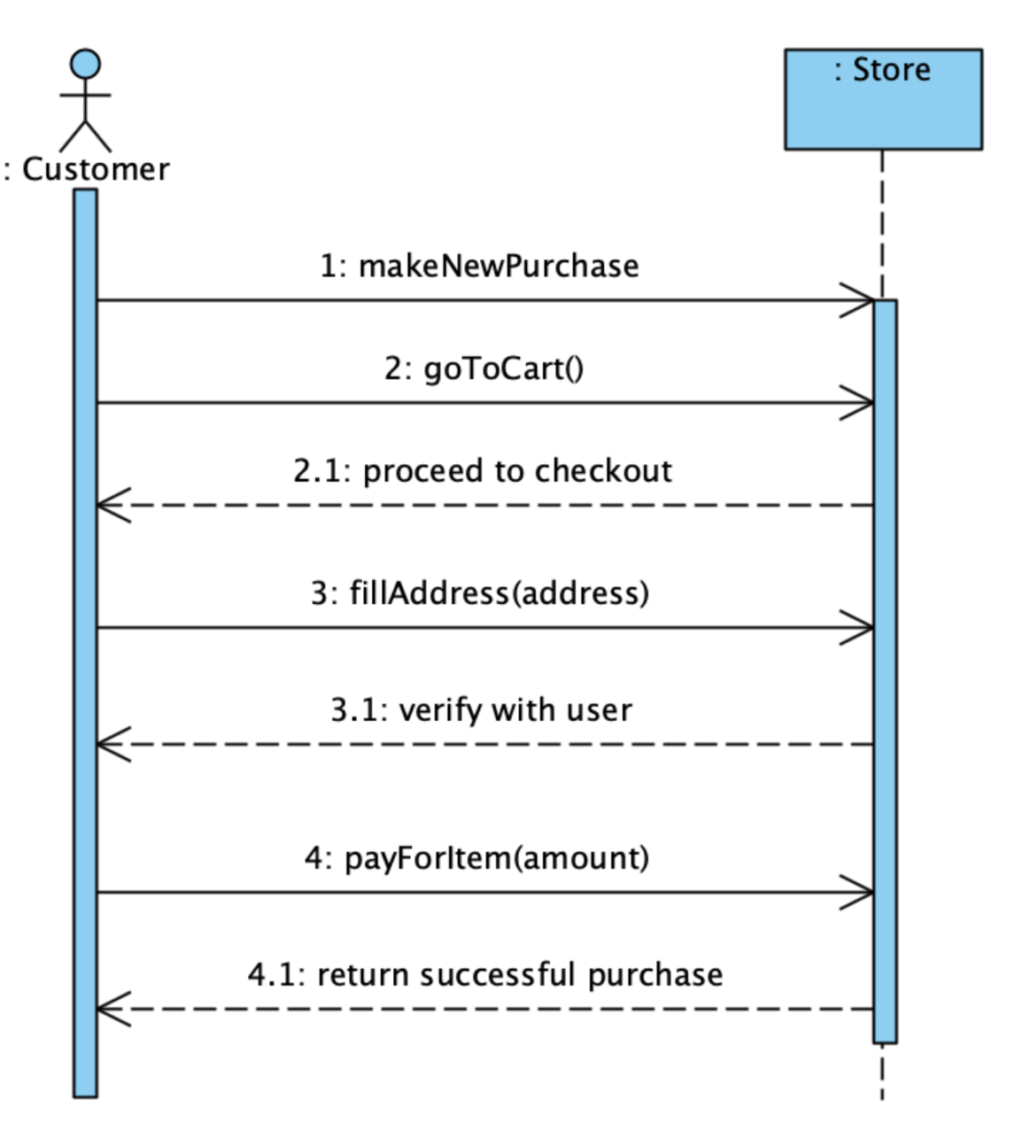
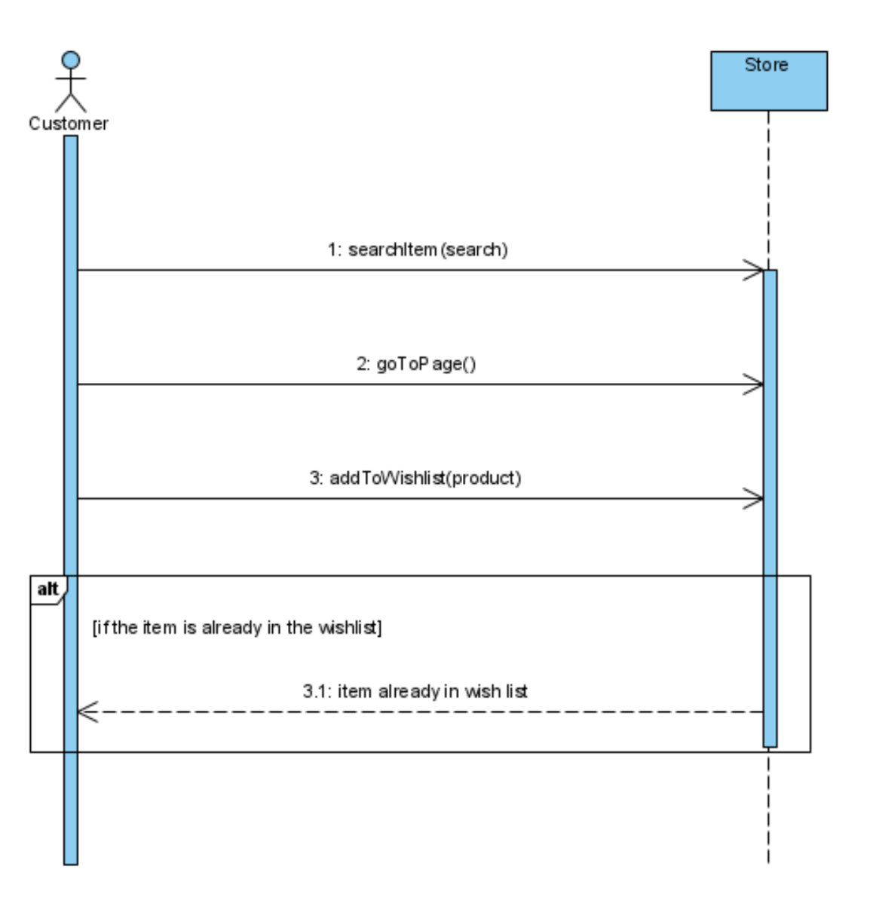
SSD

Slide 13
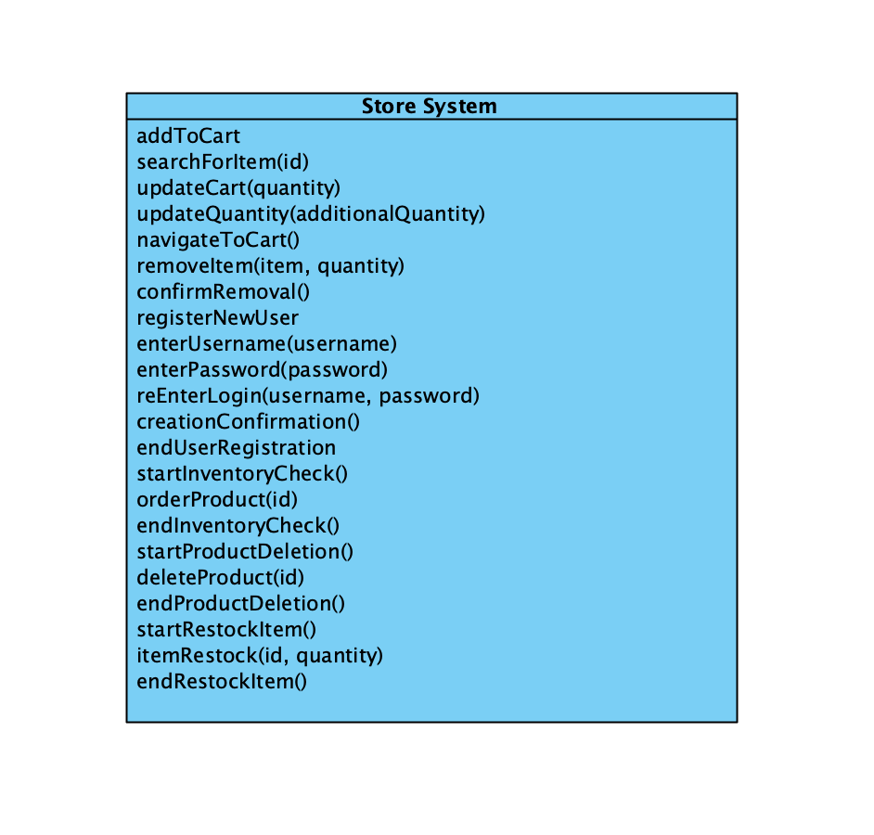
Operations

Slide 14
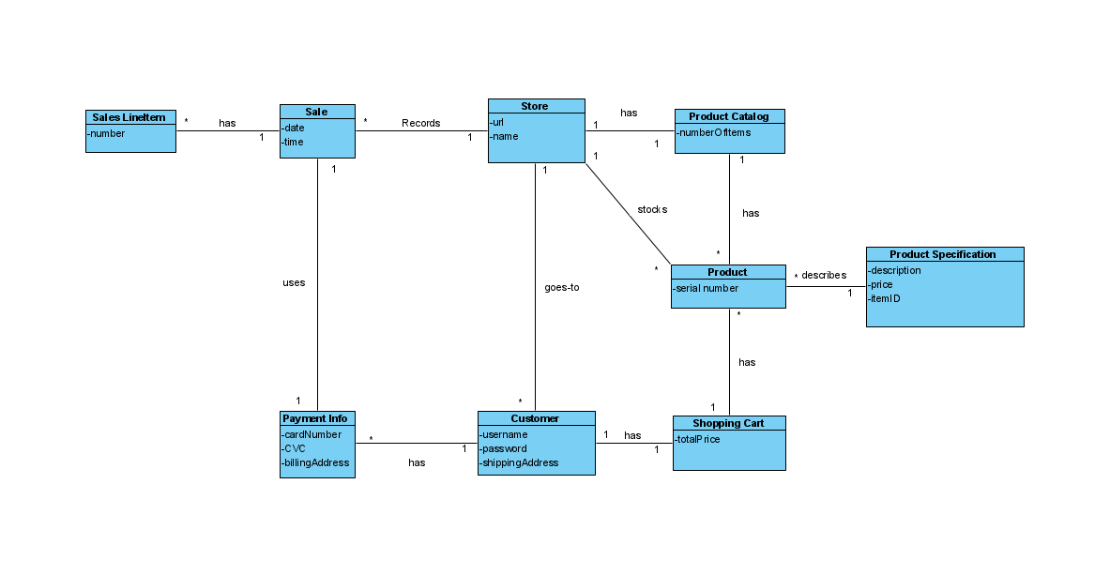
Domain Model

Slide 15
Hours Worked by Each Member
Ashley- 13
Joshua-
Austin- 18 (Self taught HTML and CSS)
Tyler- 10

